Slide 2
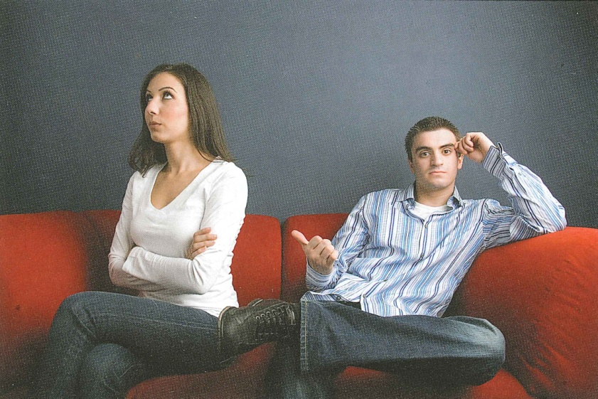
Marriage

Slide 3
Gen 2:18-25
Defining elements of marriage
Purpose of marriage

Slide 4
The Principle of the Triangle
God
Man
Woman

Slide 5
Gen 2:18-25
Defining elements of marriage
Purpose of marriage
Mathematics of marriage

Slide 6
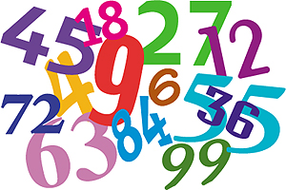
The Mathematics of Marriage
One & One = One

Slide 7
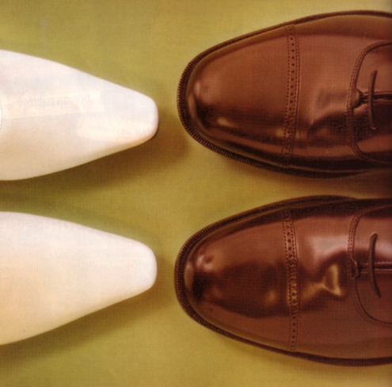
The Husband & Wife are different
In background
Practical Differences
In personality
Sleep habits
In needs
Food choices
In spirit
Movie tastes
Spiritually
Amount of time to get ready
Emotionally
Physically

Slide 8
How can One & One Equal One?

Slide 9
A house divided cannot stand (Mt 12:25)
Phil 1:27 Only conduct yourselves in a manner worthy of the gospel of Christ; so that whether I come and see you or remain absent, I may hear of you that you are standing firm in one spirit, with one mind striving together for the faith of the gospel;
O
N
E
Spirit

Slide 10
A house divided cannot stand (Mt 12:25)
Rom 15:6 that with one accord you may with one voice glorify the God and Father of our Lord Jesus Christ.
O
N
E
Spirit
Voice

Slide 11
A house divided cannot stand (Mt 12:25)
O
N
E
Acts 15:25 it seemed good to us, having become of one mind, to select men to send to you with our beloved Barnabas and Paul,
Spirit
Voice
Mind

Slide 12
How can One & One Equal One?

Slide 13
One of the most difficult aspects of Marriage Mathematics
1. The fact that men and women think differently

Slide 14
Men are like waffles
They live in one box at a time
If they do not see a problem, then they do not feel the need to open that box
Men tend to only open boxes that they are comfortable with
If too many boxes are open at once, a man will shut down from system overload

Slide 15
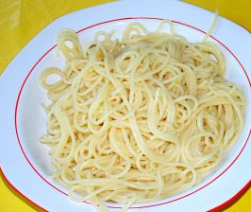
Women are like spaghetti
They see everything connected together & everything touches everything else
Women can link together emotional, logical, spiritual and relational aspects of every issue.
Women tend to be in conversational mode and men in the fix it mode.

Slide 16
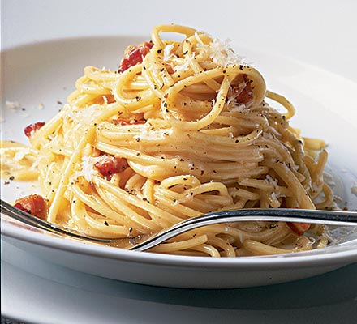
Women want to talk about many issues and the thoughts and feelings behind them.

Slide 17
While she is doing that, her man is jumping from one box to another trying to keep up with her, looking for solutions and trying to close boxes as she talks about work, friends, family, feelings, church and the future in one conversation.

Slide 18
As the conversation ends, she feels frustrated that he doesn’t talk about how he feels and he is overwhelmed with all the boxes that he just journeyed through.

Slide 19
How can boxes and spaghetti become one?

Slide 20
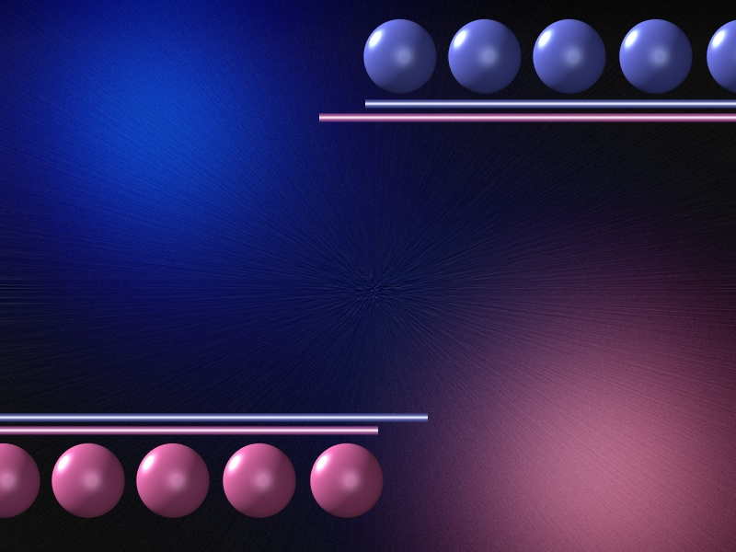
One and one equals one when:
1. A couple develops the “team concept”
1 Cor 13:5 “it does not seek its own”
The biggest problem in marriage is not falling out of love, but becoming selfish

Slide 21
One and one equals one when:
1. A couple develops the “team concept”
1 Cor 12:26 “And if one member suffers, all the members suffer with it; if one member is honored, all the members rejoice with it”

Slide 22
The team concept
Communicates with each other
Defend each other
Support each other
Help each other
Finances
Raising kids
Spiritually

Slide 23
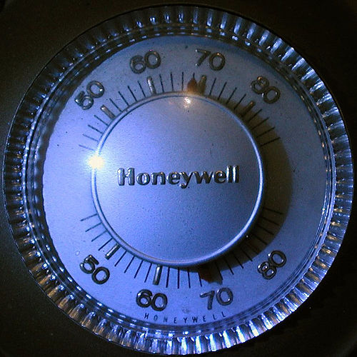
2. When a couple understands the principle of the thermostat
Love: Does not take into account a wrong suffered (1 Cor 13:5)
Peterson: “Love doesn’t keep score”

Slide 24
The thermostat must changed if the temperature is uncomfortable

Slide 25
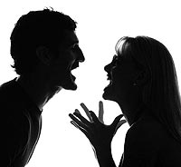
Some will use emotional tricks to get what they want
guilt
whine
nag
Bring up the past
shout
cry
threats

Slide 26
Prov 15:1 “A gentle answer turns away wrath, but a harsh word stirs up anger.”
17:14 “The beginning of strife is like letting out water, so abandon the quarrel before it breaks out.”
25:23 “The north wind brings forth rain, and a backbiting tongue, an angry countenance.”
29:22 “An angry man stirs up strife, and a hot-tempered man abounds in transgression.”

Slide 27
3. Men take on the role of the Point Man
Men are the eyes and ears of the home
They are to be the spiritual leaders of the home

Slide 28
The point man
Sacrifices what he wants for what is best for the family
Not put family in unnecessary danger
Must be sharp, alert and attentive to what is going on at home
Understands the enemy is near

Slide 29
One and one equal one when a man and a woman are walking with the Lord

